Slide 1
PALM ISLAND (Palm Jumeira) (The Man made artificial Island)
Kamalpreet Kaur
RAJVIR AUJLA

Slide 2
Project Overview
Researching on one of the best island called Palm Island
Analysis of planning and construction
SWOT Analysis
Analysis of three constraints: Cost, Time and Scope
Risks and Threats
Quality Management
Success and Failure analysis
Final Outcome.

Slide 3
INTRODUCTION
Palm island is composed of three islands:
Palm Jumeirah
Palm Jebel Ali
Palm Deira
It is located in Dubai, Untied, Arab Emirates.
It is in the shape of palm tree.

Slide 4
Introduction
Concept design Helman Hurley and Charvat Peacock
It was handed over to nakheel properties

Slide 5
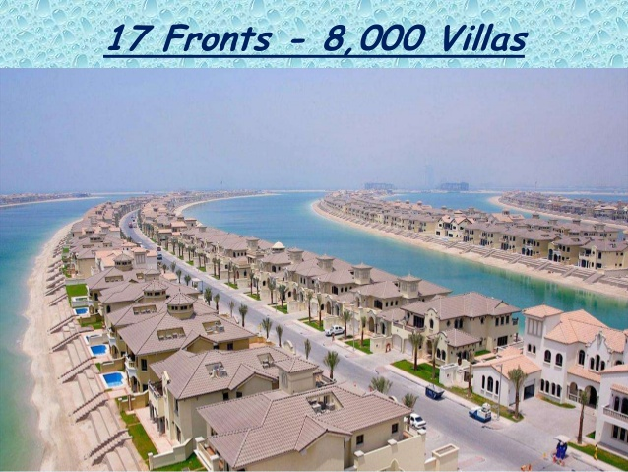
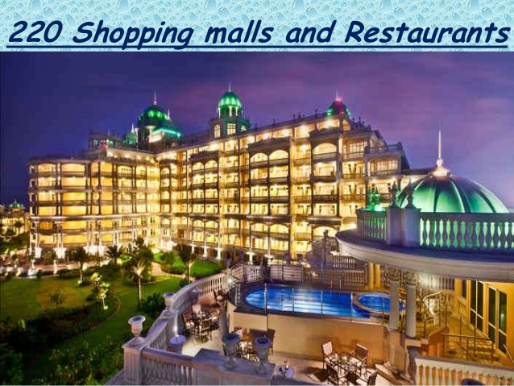
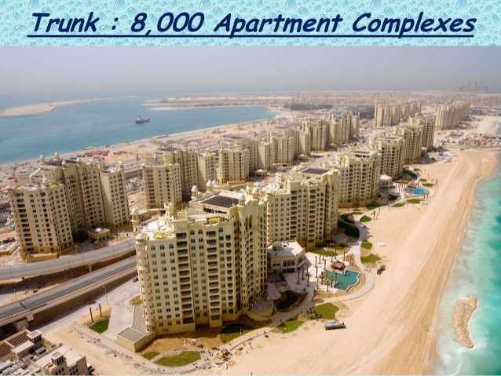
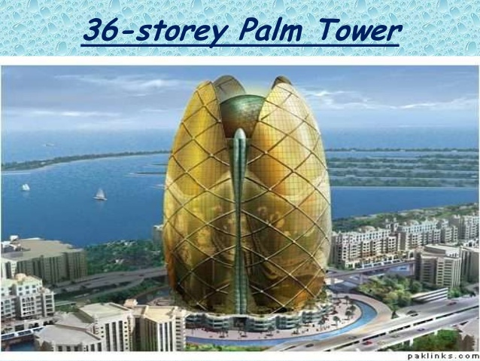

Slide 6
Palm jumeirah
It is one of the three palm islands
The Palm Jumeirah is the smallest and the original of three
It’s area is larger than 800 football grounds.

Slide 7
2000
Project Announcement
2001-03
Breakwater Construction
2003
Land Reclamation
2004-06
Constructing City
2006
Partial Completion
2008
Final Completion

Slide 8
Website
http://rajviraujlapmp.weebly.com/

Slide 9
Planning
It was a four year project plan.
It is designed to develop tourism in Dubai
Building a city at sea (covered with luxury villas, apartments, towns and homes, entertainment areas, shopping malls, restaurants etc.)

Slide 10
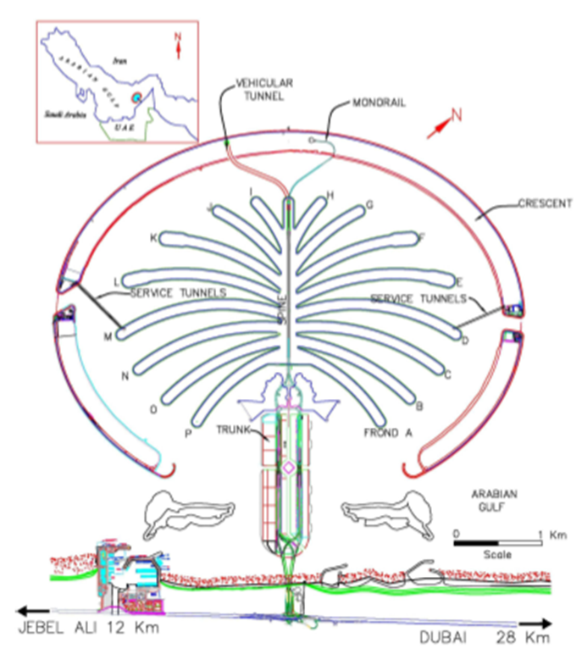
Construction
Construction process was started in the August of 2001.
It was constructed through process of land reclamation

Slide 11
Construction(cont.)
First of all, construction of 11.5km long breakwater was started.
Total of 40,000 of the workers were hired from the Asia and different parts of the country.
There were two shifts of 12 hours. So, it was being built 24 hours.

Slide 12
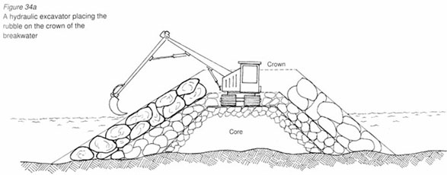
Construction(cont.)
The breakwater consists of three layers:
Initial layer: of sand built up 7.5km from the sea floor.
Second layer: rock that reaches 3m above the sea level.
Final level: Armor stone on top, 6 tons each

Slide 13
CONSTRUCTION(cont.)
Breakwater was used to manage the earthquakes.
To get the complex shape just right, designers and contractors use GPS to plot the palm.
Palm island is the best example of today’s technology.

Slide 14
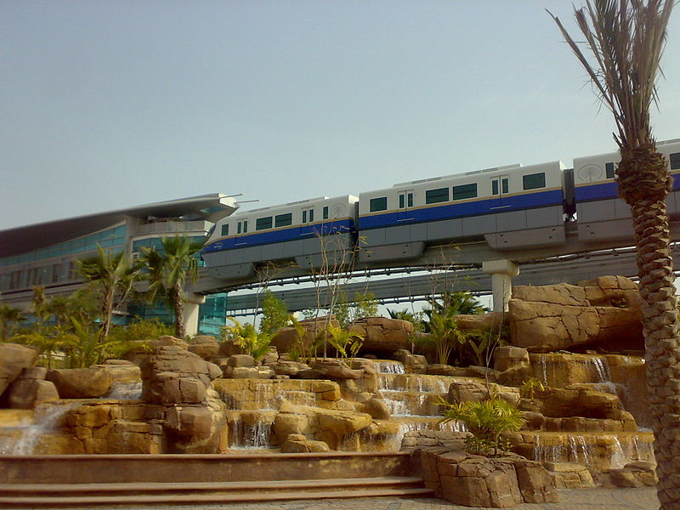
How to reach?
There is railing facility called mono Railing
Monorail uses Hitachi Monorail straddle-type technology
Opened on 30 April 2009
There are 4 stations

Slide 15
SWOT ANALYSIS
Strength:
Palm Island has increased the number of tourists.
It has also solved the land reclamation problem.
Weaknesses:
Erosion of Sand that is caused by winds and water.
Loss of coastal shape along the sea shore.

Slide 16
SWOT ANALYSIS
Opportunities:
It has also increased the revenue of the country.
Meets the requirement of the growing tourism
Threats:
High waves.
More storm frequency.
More earthquakes.

Slide 17
Scope
Because of the less geographic area and increasing no of visitors, they decided to build Palm Island.
It attracts more than million tourists every year.
This idea proves itself as a major revenue turning source for the country.

Slide 18
Cost
Estimated cost was around 2 billion USD (1.5 billion USD).
The final cost was 12.3 USD
The cost was managed by overcoming all the revenue weaknesses of Dubai.

Slide 19
Time
completion date was expected to be end of 2005.
Delayed by 2 years
Reasons of Delay
Erosion
Due to the shape of the island right outside the coast of Dubai, there is loss of coastal shape along the seashore of Dubai

Slide 20
Quality Management
Quality was managed by putting more of armor and rocks to make the sand harder and to prevent it from storms.
Breakwater was used to manage the earthquakes.
Day by Day palm island is improved by changing technology.

Slide 21
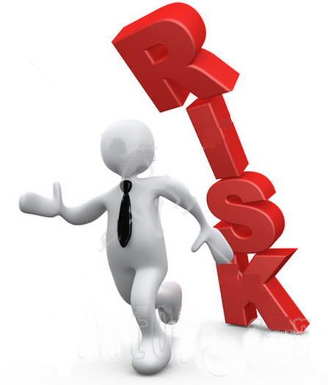
Risks and threatens
Storm frequency of 1 in 100 years
Waves 2 meter high
Earthquakes from 6 to 7 on the Richter scale. (Gulf area between Dubai and Iran is prone to earthquakes.)
Weak soil due to constant exposure to rising sea water.
Due to crisis the foreign investors stopped to invest.

Slide 22
Effect on environment
It effects area's marine environment. Rocks and sand damaged oyster beds and coral reefs. Meanwhile, the owners of once-desirable shore properties complain that the islands have destroyed their view.

Slide 23
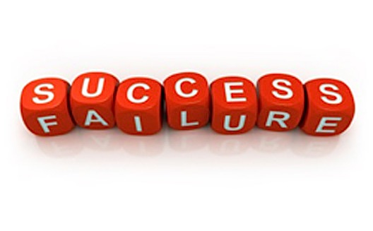
Success or failure
The project is an overall failure
It tooks 2 years more to get completed
The cost was too high than expected

Slide 24
Project Outcomes
Cost and time was too high than expected.
Success in building a largest artificial island.
In 3 days more than 800 houses were sold.
Increased tourism in Dubai

Slide 25
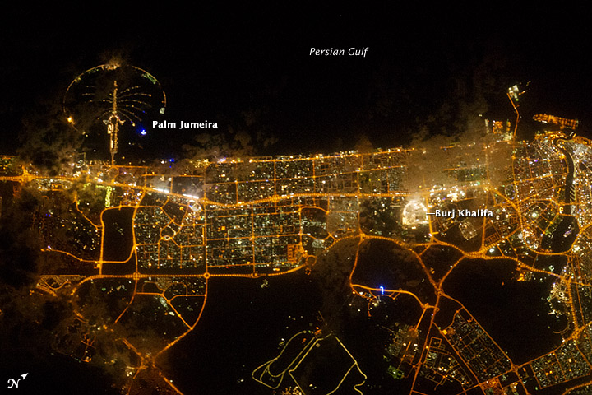

Slide 26
References
http://en.wikipedia.org/wiki/Palm_Islands
http://www.dubai-architecture.info/DUB-033.htm
http://www.aboutcivil.org/palm-island-dubai-megastructure.html

